Slide 1
An Introduction to Parallel Programming
Peter Pacheco
Chapter 4
Shared Memory Programming with Pthreads (Part 2)
Copyright © 2010, Elsevier Inc. All rights Reserved
Notes:
The University of Adelaide, School of Computer Science
Chapter 2 — Instructions: Language of the Computer

Slide 2
Roadmap
Programming with POSIX threads.
  Refresh
  Incorrect passing of information
  Joining threads
  Mutex
  Slides 3 to 13 are a review of the previous lecture
  Go to slide 14 for new content
# Chapter Subtitle
Copyright © 2010, Elsevier Inc. All rights Reserved
Notes:
The University of Adelaide, School of Computer Science
Chapter 2 — Instructions: Language of the Computer

Slide 3
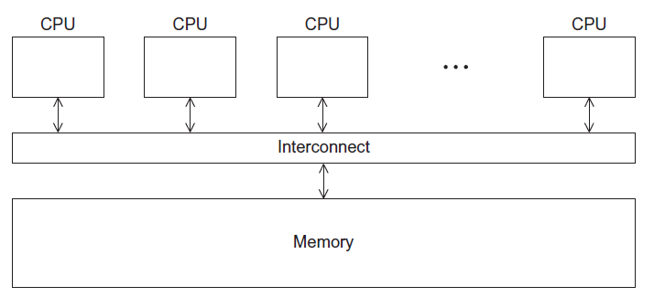
A Shared Memory System
Copyright © 2010, Elsevier Inc. All rights Reserved

Slide 4
Why and what types of threads we will use
Why?: In shared memory multiprocessor architectures, threads can be used to implement parallelism.
Which one?: For UNIX systems, POSIX threads, or Pthreads.
What is it?: an independent stream of instructions that can be scheduled to run as such by the operating system
Is "lightweight" because most of the overhead has already been accomplished through the creation of its process.
This independent flow of control is accomplished because a thread maintains its own:
Stack pointer
Registers
Scheduling properties (such as policy or priority)
Set of pending and blocked signals
Thread specific data.
Copyright © 2010, Elsevier Inc. All rights Reserved

Slide 5
More about pthreads
In summary, in the UNIX environment a thread → Exists within a process and uses the process resources AND …
Has its own independent flow of control as long as its parent process exists and the OS supports it
Duplicates only the essential resources it needs to be independently schedulable
May share the process resources with other threads that act equally independently (and dependently)
Dies if the parent process dies - or something similar
Copyright © 2010, Elsevier Inc. All rights Reserved

Slide 6
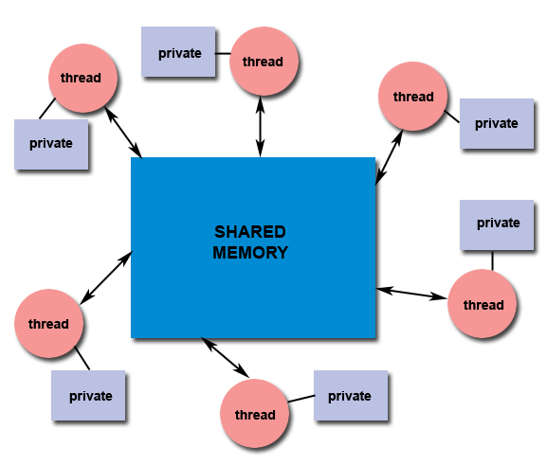
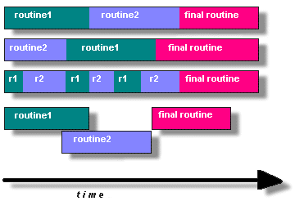
Candidates for pthreads
Copyright © 2010, Elsevier Inc. All rights Reserved

Slide 7
Terminating Threads & pthread_exit():
There are several ways in which a thread may be terminated:
The thread returns normally from its starting routine. Its work is done.
The thread makes a call to the pthread_exit subroutine - whether its work is done or not.
The thread is canceled by another thread via the pthread_cancel routine
The entire process is terminated due to making a call to either the exec() or exit()
If main() finishes first, without calling pthread_exit explicitly itself
Copyright © 2010, Elsevier Inc. All rights Reserved

Slide 8
Terminating Threads & pthread_exit():
The pthread_exit() routine allows the programmer to specify an optional termination status parameter. This optional parameter is typically returned to threads "joining" the terminated thread (covered later).
In subroutines that execute to completion normally, you can often dispense with calling pthread_exit() - unless, of course, you want to pass the optional status code back.
Cleanup: the pthread_exit() routine does not close files; any files opened inside the thread will remain open after the thread is terminated.
Copyright © 2010, Elsevier Inc. All rights Reserved

Slide 9
Terminating Threads & pthread_exit():
Discussion on calling pthread_exit() from main():
There is a definite problem if main() finishes before the threads it spawned if you don't call pthread_exit() explicitly. All of the threads it created will terminate because main() is done and no longer exists to support the threads.
By having main() explicitly call pthread_exit() as the last thing it does, main() will block and be kept alive to support the threads it created until they are done.
Copyright © 2010, Elsevier Inc. All rights Reserved

Slide 10
Compiling (Option 2)
gcc FileName.c -o ExecutableName -lpthread
Copyright © 2010, Elsevier Inc. All rights Reserved

Slide 11
Let’s go for some code
Pthread Creation and Termination
PthreadsEx1
This simple example code creates 5 threads with the pthread_create() routine.
Each thread prints a "Hello World!" message, and then terminates with a call to pthread_exit().
Copyright © 2010, Elsevier Inc. All rights Reserved

Slide 12
Let’s go for some code
Thread Argument Passing
PthreadsEx2
This code fragment demonstrates how to pass a simple integer to each thread.
The calling thread uses a unique data structure for each thread, insuring that each thread's argument remains intact throughout the program.
Copyright © 2010, Elsevier Inc. All rights Reserved

Slide 13
Let’s go for some code
Thread Argument Passing
PthreadsEx3
This example shows how to setup/pass multiple arguments via a structure. Each thread receives a unique instance of the structure.
Copyright © 2010, Elsevier Inc. All rights Reserved

Slide 14
Let’s go for some code
Thread Argument Passing
PthreadsEx4
This example performs argument passing incorrectly. It passes the address of variable t, which is shared memory space and visible to all threads. As the loop iterates, the value of this memory location changes, possibly before the created threads can access it. (FOR STUDENTS)
Copyright © 2010, Elsevier Inc. All rights Reserved

Slide 15
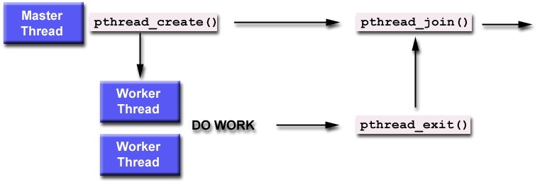
Joining
It is one way to accomplish synchronization between threads
The pthread_join() subroutine blocks the calling thread until the specified threadid thread terminates
Copyright © 2010, Elsevier Inc. All rights Reserved

Slide 16
Joining
When a thread is created, one of its attributes defines whether it is joinable or detached.
Only threads that are created as joinable can be joined. If a thread is created as detached, it can never be joined.
The final draft of the POSIX standard specifies that threads should be created as joinable.
To explicitly create a thread as joinable or detached, the attr argument in the pthread_create() routine is used. The typical 4 step process is shown in our next slide
Copyright © 2010, Elsevier Inc. All rights Reserved

Slide 17
Joining (4 steps)
Declare a pthread attribute variable of the pthread_attr_t data type
Initialize the attribute variable with pthread_attr_init()
Set the attribute detached status with thread_attr_setdetachstate()
When done, free library resources used by the attribute with pthread_attr_destroy()
Copyright © 2010, Elsevier Inc. All rights Reserved

Slide 18
Detaching:
The pthread_detach() routine can be used to explicitly detach a thread even though it was created as joinable.
There is no converse routine.
Copyright © 2010, Elsevier Inc. All rights Reserved

Slide 19
General recommendation about Joining and Detaching:
If a thread requires joining,
  consider explicitly creating it as joinable. This provides portability as not all implementations may create threads as joinable by default.
If you know in advance that a thread will never need to join with another thread, consider creating it in a detached state. Some system resources may be able to be freed
Copyright © 2010, Elsevier Inc. All rights Reserved

Slide 20
Stopping the Threads
We call the function pthread_join once for each thread.
A single call to pthread_join will wait for the thread associated with the pthread_t object to complete.
Copyright © 2010, Elsevier Inc. All rights Reserved

Slide 21
Let’s go for some code
Joining
PthreadsEx5
This example demonstrates how to "wait" for thread completions by using the Pthread join routine. Since some implementations of Pthreads may not create threads in a joinable state, the threads in this example are explicitly created in a joinable state so that they can be joined later.
Copyright © 2010, Elsevier Inc. All rights Reserved

Slide 22
Stack Management
What is the stack?
Default thread stack size varies greatly. The maximum size that can be obtained also varies greatly, and may depend upon the number of threads per node.
Both past and present architectures are shown to demonstrate the wide variation in default thread stack size.
Node Architecture | #CPUs | Memory (GB) | Default Size (bytes)
Intel Xeon E5-2670 | 16 | 32 | 2,097,152
Intel Xeon 5660 | 12 | 24 | 2,097,152
AMD Opteron | 8 | 16 | 2,097,152
Intel IA64 | 4 | 8 | 33,554,432
Intel IA32 | 2 | 4 | 2,097,152
IBM Power5 | 8 | 32 | 196,608
IBM Power4 | 8 | 16 | 196,608
IBM Power3 | 16 | 16 | 98,304
Copyright © 2010, Elsevier Inc. All rights Reserved

Slide 23
Preventing Stack Problems:
The POSIX standard does not dictate the size of a thread's stack. This is implementation dependent and varies.
Copyright © 2010, Elsevier Inc. All rights Reserved

Slide 24
Stack Management (Routines)
Size related:
pthread_attr_getstacksize (attr, stacksize)
pthread_attr_setstacksize (attr, stacksize)
Address Related
pthread_attr_getstackaddr (attr, stackaddr)
pthread_attr_setstackaddr (attr, stackaddr)
Copyright © 2010, Elsevier Inc. All rights Reserved

Slide 25
Stack Management
What happens when we exceed the size of our stack?
  program termination
  And / Or corrupted data.
It is easy to exceed this limit? Yes, it is , and happens quite often
Copyright © 2010, Elsevier Inc. All rights Reserved

Slide 26
Stack Management
Safe and portable programs:
  Do not depend upon the default stack limit
  Instead, explicitly allocate enough stack for each thread by using:
    pthread_attr_setstacksize.
pthread_attr_getstackaddr & pthread_attr_setstackaddr
  Can be used by applications in an environment where the stack for a thread must be placed in some particular region of memory.
Copyright © 2010, Elsevier Inc. All rights Reserved

Slide 27
Let’s go for some code
Stack management
PthreadsEx6
This example demonstrates how to query and set a thread's stack size.
Copyright © 2010, Elsevier Inc. All rights Reserved

Slide 28
Mutex Variables
Mutex = Mutex = Mutual Exclusion
One of the primary means of implementing thread synchronization and for protecting shared data when multiple writes occur.
Acts like a "lock" protecting access to a shared data resource.
  What does it mean ?? (see next slide)
Copyright © 2010, Elsevier Inc. All rights Reserved

Slide 29
Mutex Variables
The basic concepts of a mutex when used in Pthreads are:
  Only one thread can lock (or own) a mutex variable at any given time.
  If several threads try to lock a mutex only one thread will be successful.
  No other thread can own that mutex until the owning thread unlocks that mutex.
  Threads must "take turns" accessing protected data.
  This translates into → A mechanism that can be used to "race" conditions
Copyright © 2010, Elsevier Inc. All rights Reserved

Slide 30

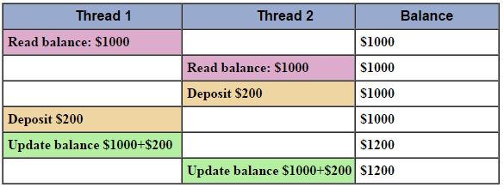
Mutex Variables- Race Condition Example
Copyright © 2010, Elsevier Inc. All rights Reserved

Slide 31
Mutex Variables
A typical sequence in the use of a mutex
Create and initialize a mutex variable
Several threads attempt to lock the mutex
Only one succeeds and that thread owns the mutex
The owner thread performs some set of actions
The owner unlocks the mutex
Another thread acquires the mutex and repeats the process
Finally the mutex is destroyed
Copyright © 2010, Elsevier Inc. All rights Reserved

Slide 32
Mutex (Routines)
pthread_mutex_init (mutex, attr)
pthread_mutex_destroy (mutex)
pthread_mutexattr_init (attr)
pthread_mutexattr_destroy (attr)
Copyright © 2010, Elsevier Inc. All rights Reserved

Slide 33
Mutex Variables
Mutex variables:
Must be declared with type pthread_mutex_t
Must be initialized before they can be used.
  There are two ways to initialize a mutex variable:
    Statically (when it is declared)
      pthread_mutex_t mymutex = PTHREAD_MUTEX_INITIALIZER
    Dynamically
      with the pthread_mutex_init() routine.
      This method permits setting mutex object attributes (attr).
The mutex is initially unlocked.
Copyright © 2010, Elsevier Inc. All rights Reserved

Slide 34
Mutex Variables
Locking and Unlocking Mutexes
pthread_mutex_lock()
pthread_mutex_trylock()
pthread_mutex_unlock()
Copyright © 2010, Elsevier Inc. All rights Reserved

Slide 35
Mutex Variables
Locking and Unlocking Mutexes
pthread_mutex_lock()
Used by a thread to acquire a lock on the specified mutex variable.
If the mutex is already locked by another thread, this call will block the calling thread until the mutex is unlocked.
Copyright © 2010, Elsevier Inc. All rights Reserved

Slide 36
Mutex Variables
Locking and Unlocking Mutexes
pthread_mutex_trylock()
Will attempt to lock a mutex. However, if the mutex is already locked, the routine will return immediately with a "busy" error code.
This routine may be useful in preventing deadlock conditions, as in a priority-inversion situation.
Copyright © 2010, Elsevier Inc. All rights Reserved

Slide 37
Mutex Variables
Locking and Unlocking Mutexes
pthread_mutex_unlock()
Will unlock a mutex if called by the owning thread.
Calling this routine is required after a thread has completed its use of protected data if other threads are to acquire the mutex for their work with the protected data.
An error will be returned if:
  If the mutex was already unlocked
  If the mutex is owned by another thread
Copyright © 2010, Elsevier Inc. All rights Reserved

Slide 38
Let’s go for some code
Mutexes
PthreadsEx7
This example program illustrates the use of mutex variables in a threads program. Each thread works on a different part of the data. The main thread waits for all the threads to complete their computations, and then it prints the resulting sum.
Copyright © 2010, Elsevier Inc. All rights Reserved

